Slide 1
Conservation of Intellectual Momentum
Staying Connected to the Field of Physics Even When Your Job Doesn’t Make You
Zachary J. Rohrbach ‘12
Avon High School
zjrohrbach@avon-schools.org
Twitter: @rohrbachsci

Slide 2
What can I say to a college physics audience that will be interesting?
The Dilemma

Slide 3
Will teaching really keep me intellectually stimulated?
The Dilemma during my Junior and Senior Years

Slide 4


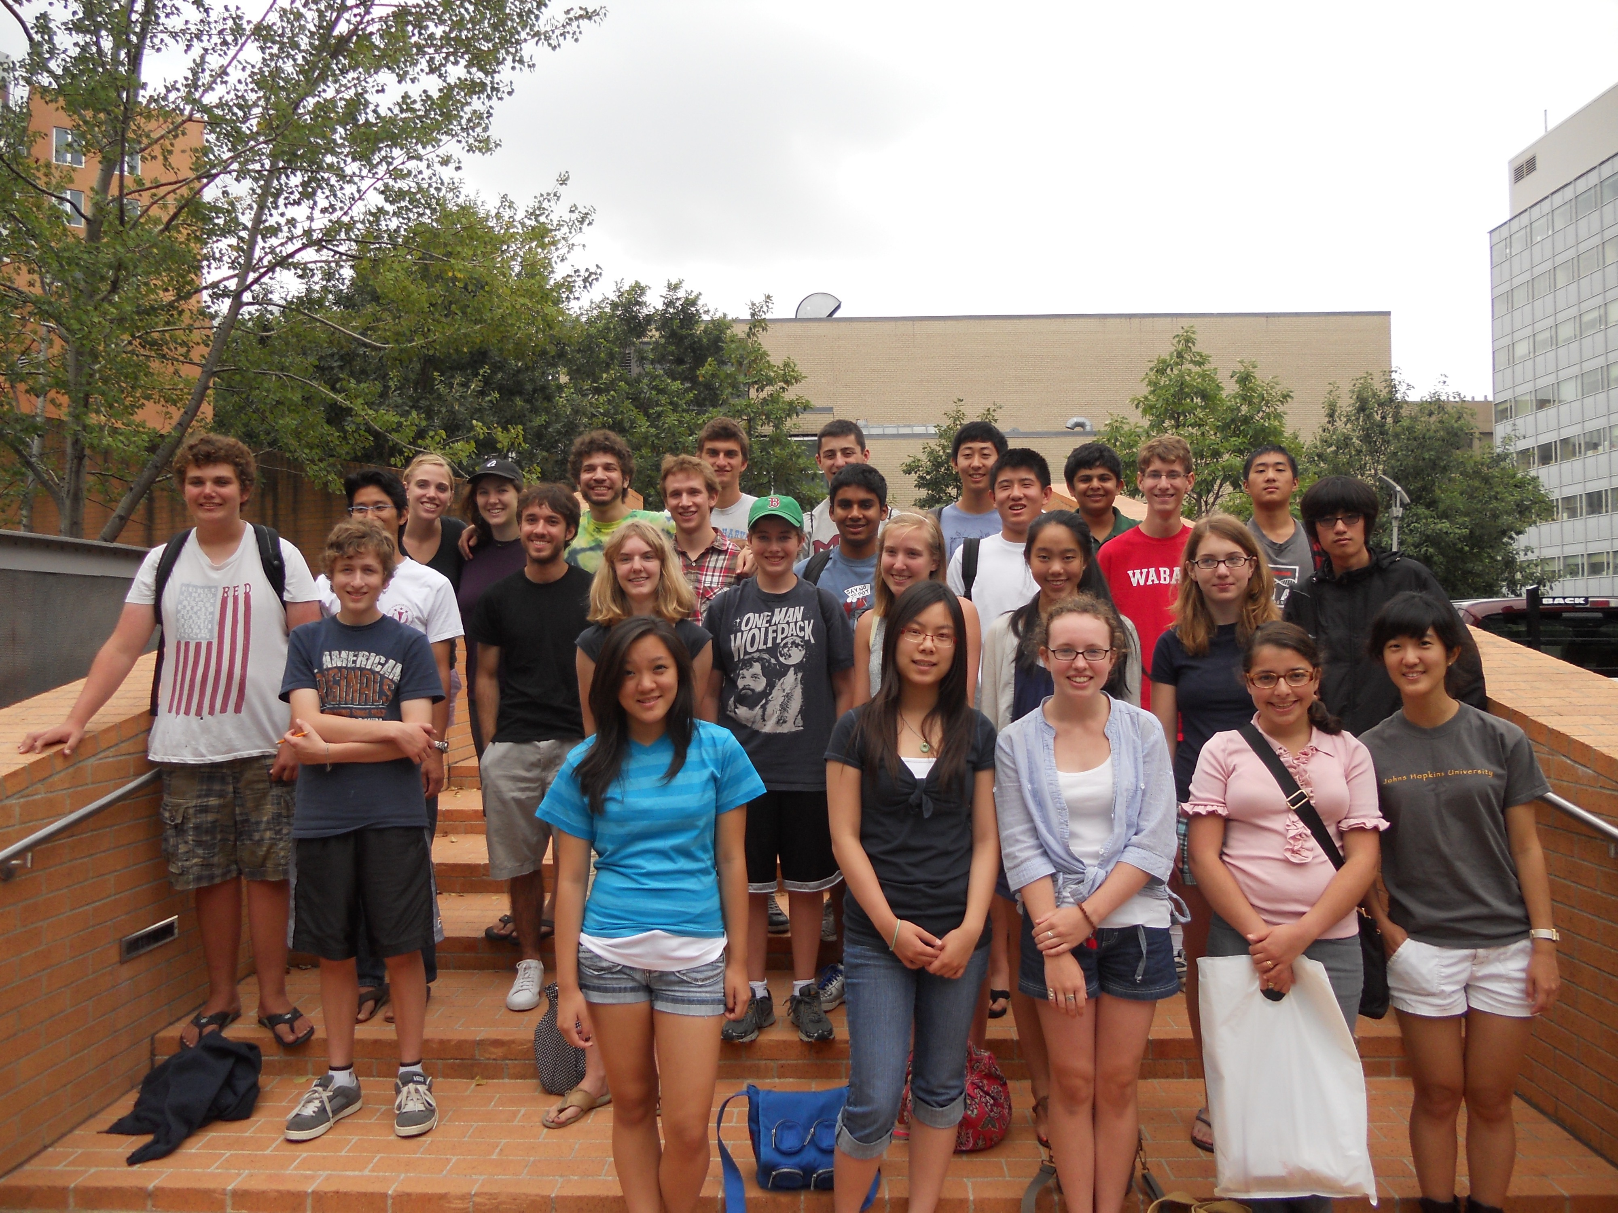
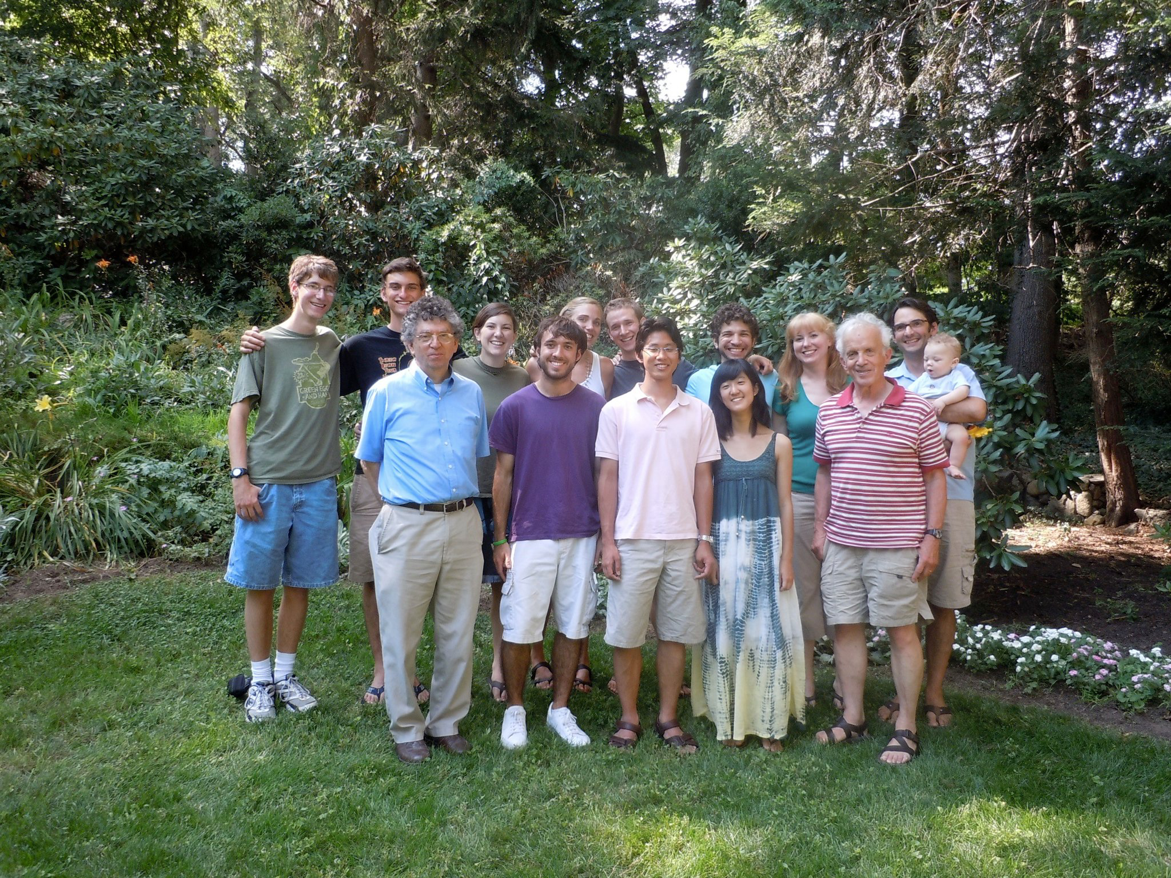
TOPS
Teaching Opportunities in Physical Science
MIT-Harvard Center for Ultracold Atoms
It’s a “T.E.U.”!

Slide 5
TOPS
“The microchip guy”

Slide 6

TOPS
Holograms

Slide 7
TOPS
Holograms

Slide 8
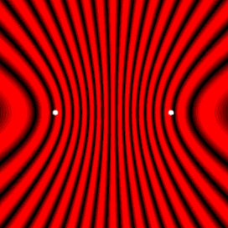
TOPS
Holograms
Laser
Source
Object

Slide 9
TOPS
Holograms

Slide 10
TOPS
Holograms
Light
Source
Virtual Image

Slide 11
YES!
Do I really want to teach?

Slide 12
Teaching physics conceptually
Keeping up in Physics after Graduating

Slide 13

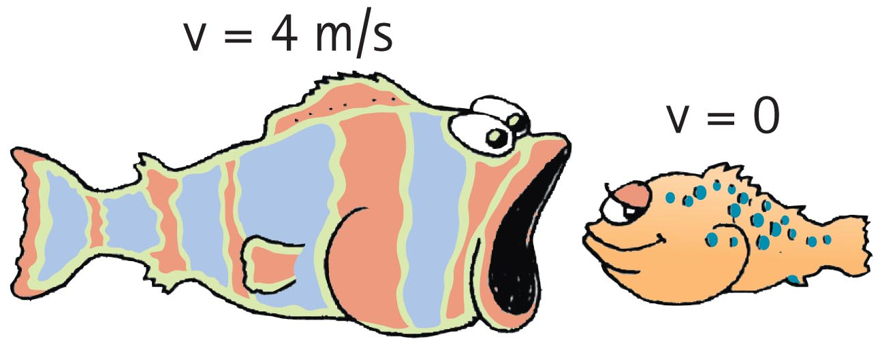
Hewitt’s Conceptual Physics
Paul Hewitt: Cartoonist turned Physicist!
“Concepts before calculations”
All images © 2015 Pearson Education, Inc.

Slide 14
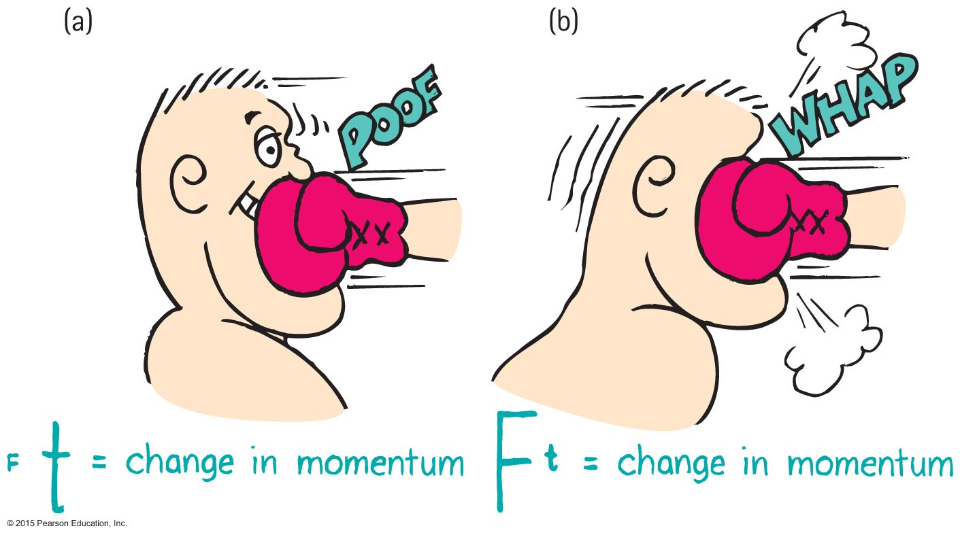
Hewitt’s Conceptual Physics
All images © 2015 Pearson Education, Inc.

Slide 15
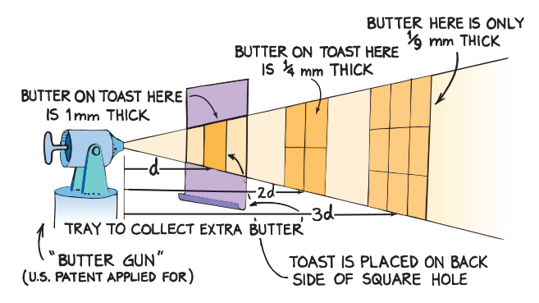
Hewitt’s Conceptual Physics
All images © 2015 Pearson Education, Inc.

Slide 16
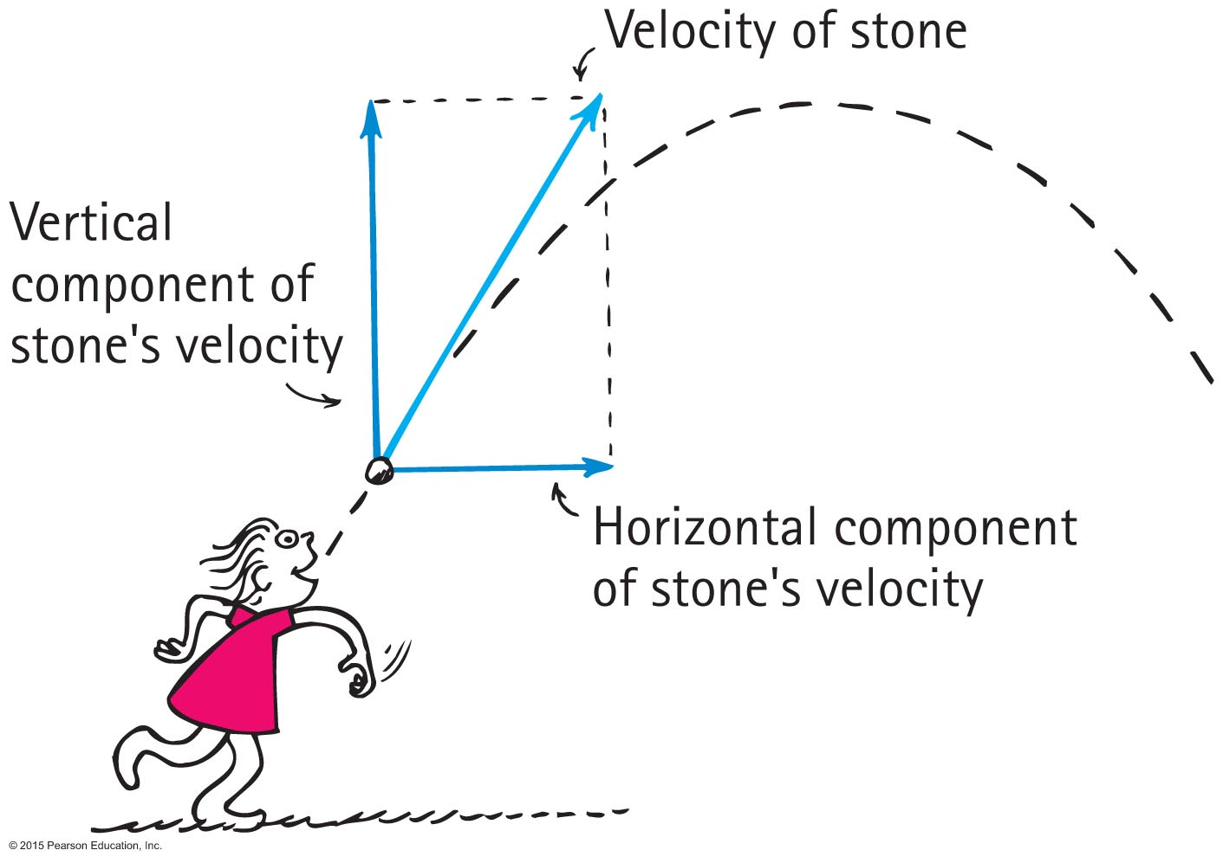
Can’t hide behind the math!
Why is 45 degrees the angle that provides the longest range for a projectile?
All images © 2015 Pearson Education, Inc.

Slide 17
Can’t hide behind the math!
Why is 45 degrees the angle that provides the longest range for a projectile?
v_{0y}
v_{0y}
v_{0y}
30°
45°
60°
v_{0x}
v_{0x}
v_{0x}
v_{0y} increases leading to more hang-time
v_{0x} increases leading to faster gain of horizontal range
demo

Slide 18
Can’t hide behind the math!
What force causes a box to slide down a ramp?

Slide 19
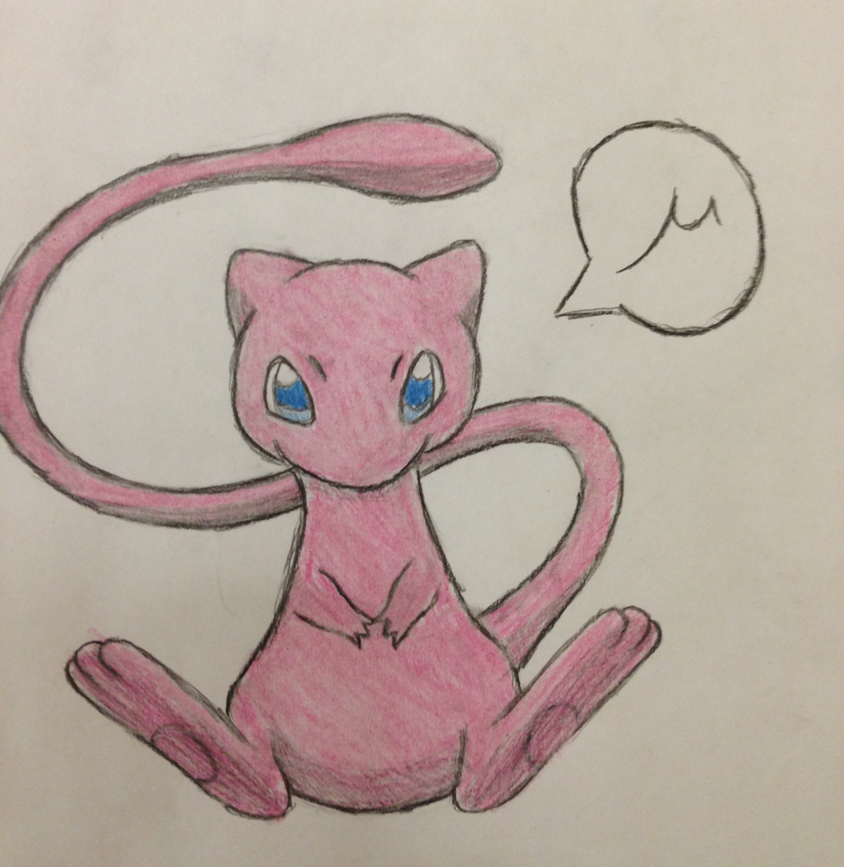
Can’t hide behind the math!
What force causes a box to slide down a ramp?

Slide 20
Getting in touch with my Experimental side
Keeping up in Physics after Graduating

Slide 21
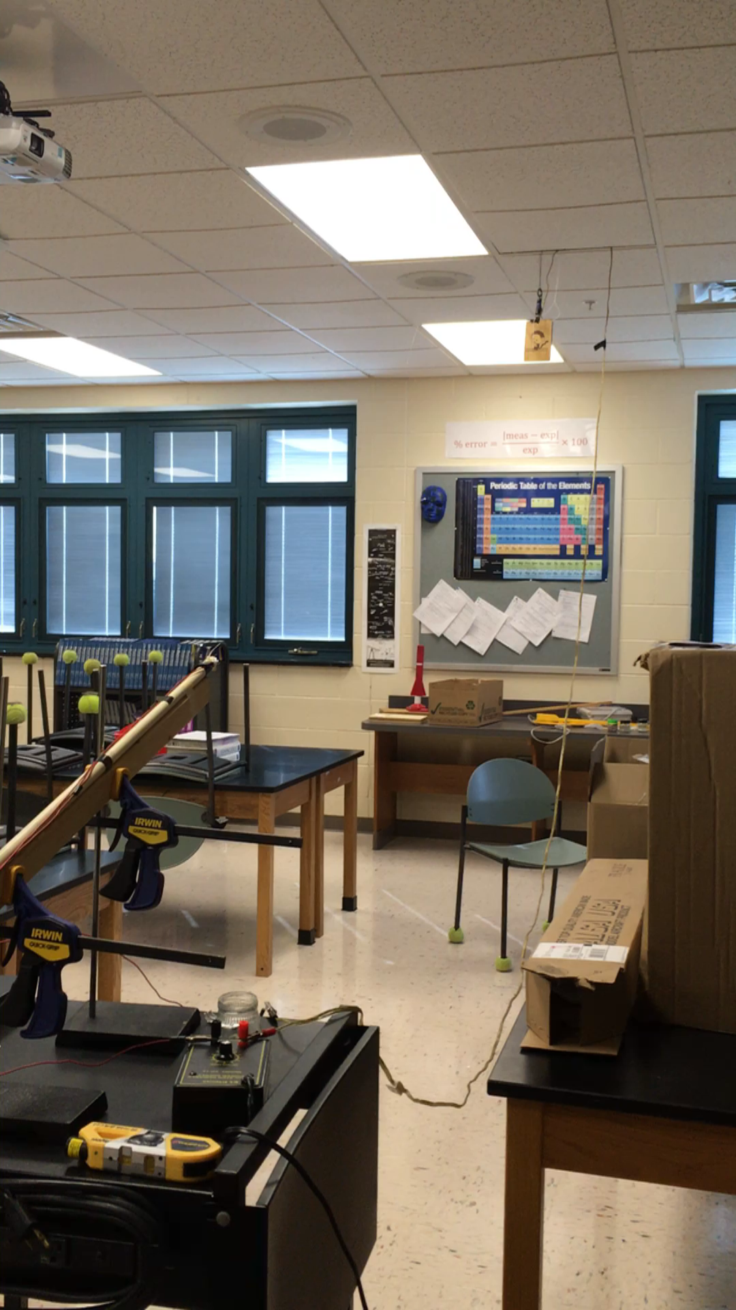
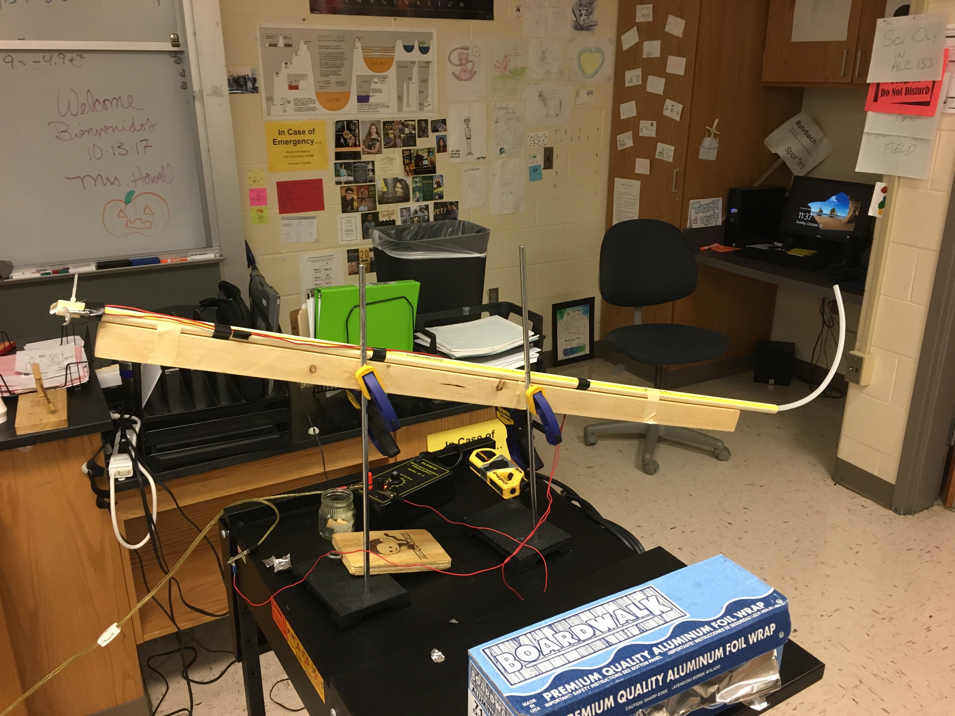
experimental Physics & Demos
Monkey & Hunter

Slide 22
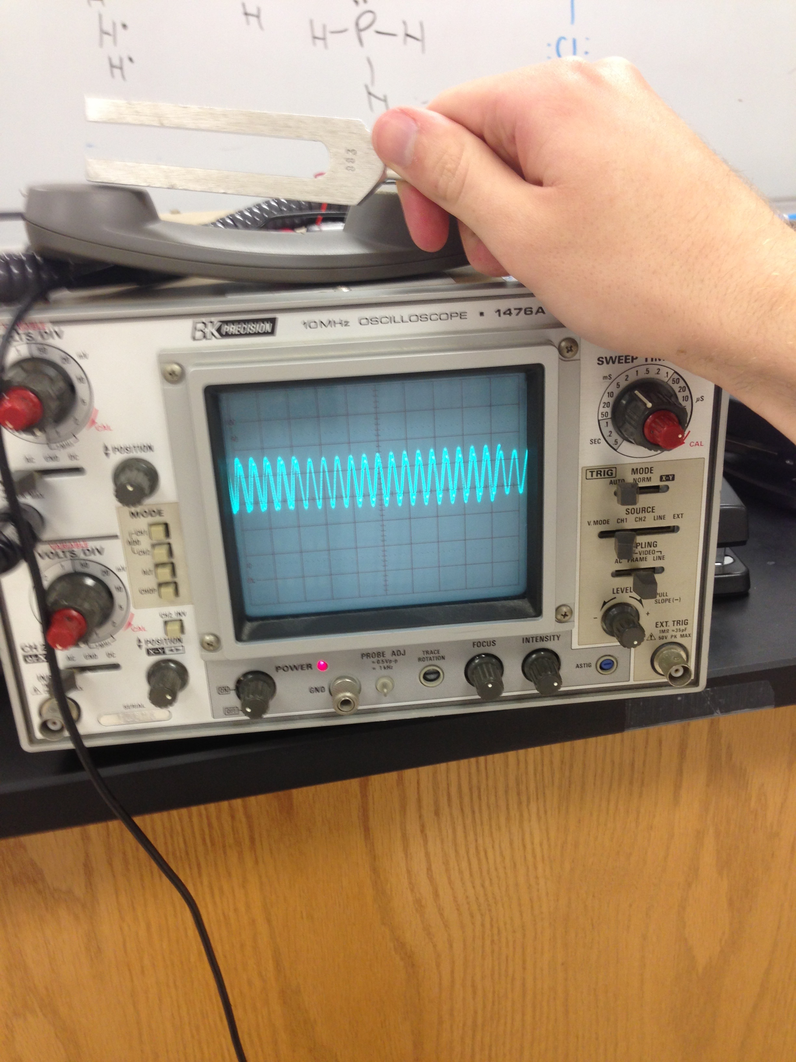
experimental Physics & Demos
Oscilloscope and Telephone

Slide 23
experimental Physics & Demos
Other Projects
Light box
Shoot-n-drop
Raspberry Pi

Slide 24
Professional Development
Keeping up in Physics after Graduating

Slide 25

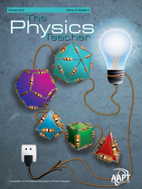
Professional Development
IN-AAPT (American Association of Physics Teachers)
High School and Undergraduate Teachers
Some about pedagogy, but also just science
Publish AJP and TPT
Keynote Speakers

Slide 26
Professional Development
Glowscript
Monkey and Hunter
Doppler Effect
Waves on a String

Slide 27
Letting the kids teach you
Keeping up in Physics after Graduating

Slide 28
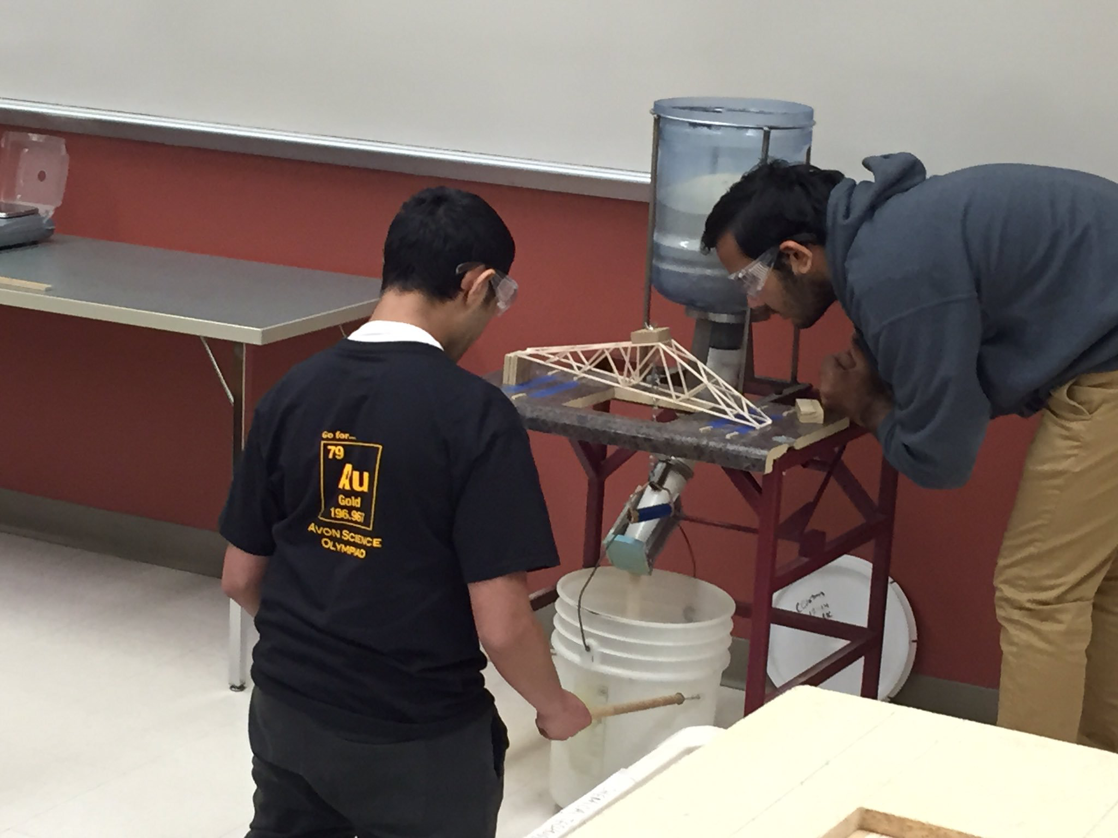
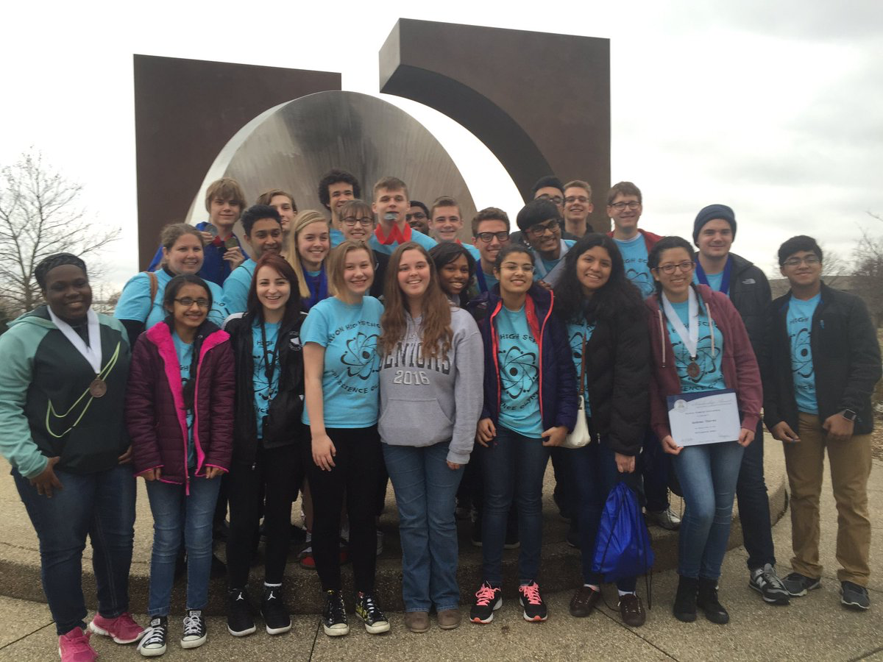
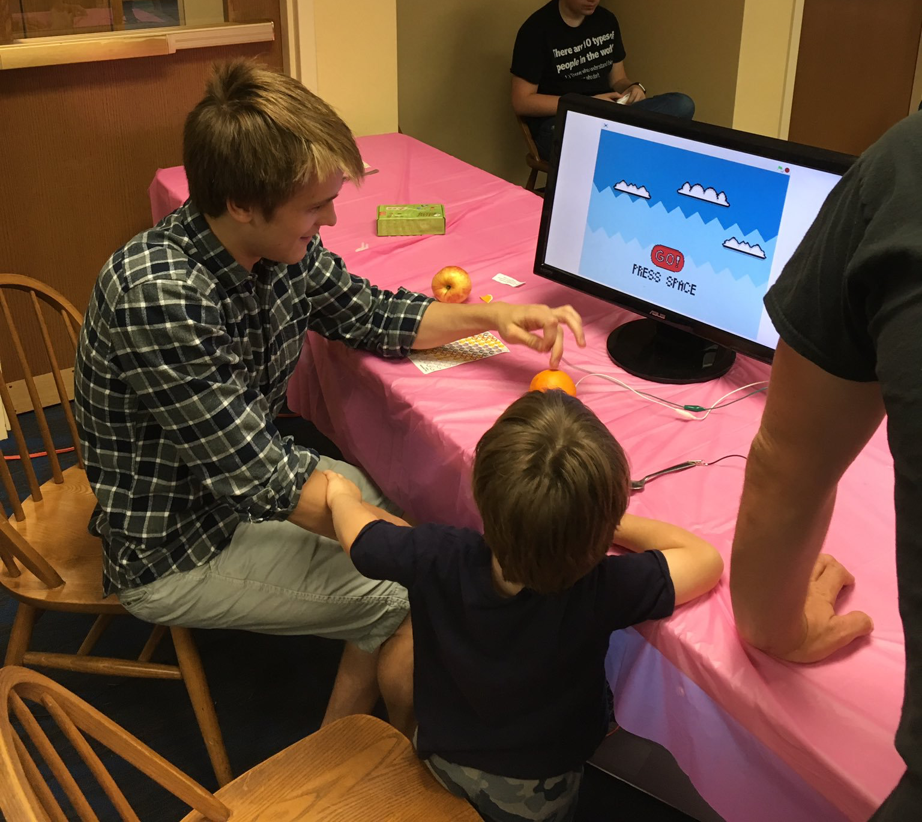
Learning from the kids
Science Olympiad
“Academic Track Meet”
23 Events
Helicopters
Rocks & Minerals
Programming
Bridge Building
Astronomy

Slide 29
Conclusion
Keeping up in Physics after Graduating

Slide 30
Conclusion
Conservation of Momentum is natural
You learn better by teaching
Your curiosity will carry you to do other interesting projects
I make an effort to stay involved (IN-AAPT)
Let the kids teach you!

